Slide 1


PipeXplorer: Software Simulation Suite for Pipeline and Superscalar Execution Analysis
Guided by
Presented by
Yuvaguru S (192511452)
Yogesh ramu B (192572178)
Manoj N (192565105)
Dr. S Senthilvadivu
Dr. Kumaragurubaran T

Slide 2


Agenda
Abstract
Introduction
Problem Identification and Analysis
Solution Design and Implementation
Module-1:Pipeline Designer and Hazard Analyzer
Module-2:Superscalar Execution Visualizer (OoO + Speculation)
Module-3:SMT and Hyper-Threading Performance Simulator
Integration of Modules
Reflection on Learning and Personal Development

Slide 3
Agenda
Conclusion
Future Scope
References

Slide 4

Abstract
PipeXplorer is a simulation suite designed for modeling pipeline and superscalar execution in processors. It visualizes instruction flow and identifies hazards during execution, helping users understand complex processor behavior. The tool evaluates the performance impacts of various design choices and simulates real-world execution scenarios to provide deeper architectural insights. With support for flexible experimentation across different configurations, PipeXplorer offers valuable guidance on optimization, instruction-level parallelism, and overall efficiency improvements in processor design.

Slide 5
Introduction
Pipeline and superscalar execution are key techniques for improving processor performance.
Their analysis is complex due to hazards, dependencies, and scheduling challenges.
PipeXplorer simplifies this by providing an interactive simulation environment.
It supports experimentation with processor behaviors and design choices.
Useful for researchers, engineers, and learners to evaluate trade-offs and optimize performance.

Slide 6
Problem Identification and Analysis
Complexity of visualizing hazards and dynamic scheduling.
Limitations of existing teaching tools or simulators.
Lack of integrated platform combining pipeline, OoO execution, and SMT analysis.
Identified gaps in accessibility (user-friendly interface for learning & research).

Slide 7
Solution Design and Implementation
PipeXplorer provides a software-based simulation environment for analyzing pipeline and superscalar execution.
It models instruction flow, detects hazards, and simulates real-time execution scenarios.
The tool incorporates visualization features to track data, control, and structural dependencies.
Users can configure pipeline stages, issue widths, and scheduling policies for experimentation.

Slide 8
Module-1: Pipeline Designer and Hazard Analyzer
PipeXplorer provides powerful features for analyzing processor pipelines and superscalar execution. It allows configuration of pipeline stages (IF, ID, EX, MEM, WB) while detecting hazards such as data (RAW, WAR, WAW), control (branch misprediction), and structural issues. Visualization tools, including timeline charts, stall cycles, and forwarding paths, enhance clarity, while an example simulation walkthrough helps users understand the analysis process effectively.
Pipeline stage configuration with hazard detection.
Visualization of stalls, forwarding, and execution flow.
Guided simulation walkthrough for practical learning.

Slide 9
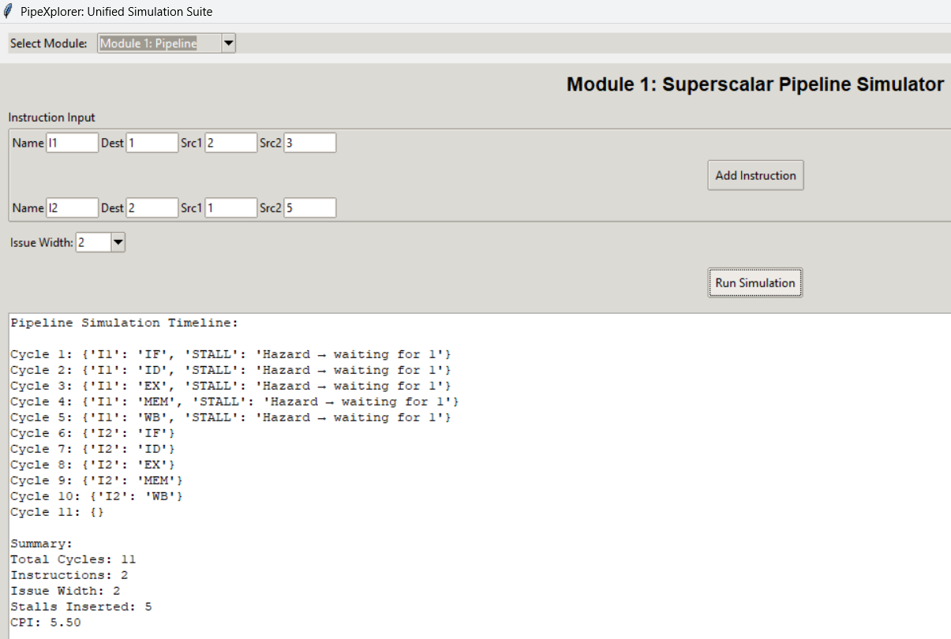
Output

Slide 10
Module-2: Superscalar Execution Visualizer (OoO + Speculation)
PipeXplorer supports superscalar instruction issue models (2-way, 4-way) and advanced out-of-order execution techniques. It incorporates reservation stations, a reorder buffer (ROB), and Tomasulo’s algorithm to handle dynamic scheduling and dependency resolution. The suite also includes speculative execution with branch prediction, alongside visualization tools for instruction scheduling, dependencies, and commit operations, making analysis more comprehensive.
Superscalar issue models with out-of-order execution support.
Includes reservation stations, ROB, and Tomasulo’s algorithm.
Visualization of scheduling, dependencies, and commit stages.

Slide 11
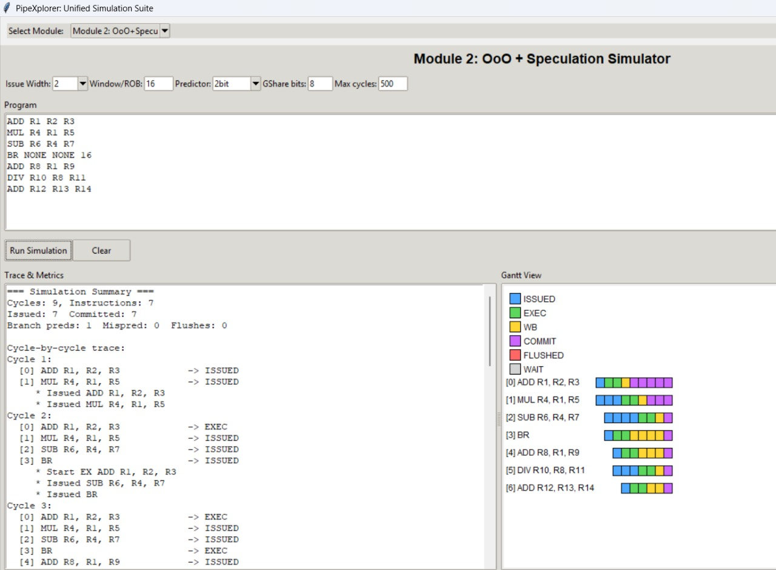

Slide 12
Module-3: SMT and Hyper-Threading Performance Simulator
PipeXplorer incorporates the concept of simultaneous multithreading (SMT), allowing multiple threads to share processor resources such as functional units and caches. It enables performance comparisons between single-threaded execution and SMT, while simulating hyper-threading behavior to evaluate efficiency. Visualization features illustrate thread interleaving, resource utilization, and throughput gains or losses, providing a clear understanding of multithreading impacts on processor performance.
Supports SMT with shared resources like functional units and caches.
Performance comparison between single-thread and multithreaded execution.
Visualization of thread interleaving and throughput effects.

Slide 13
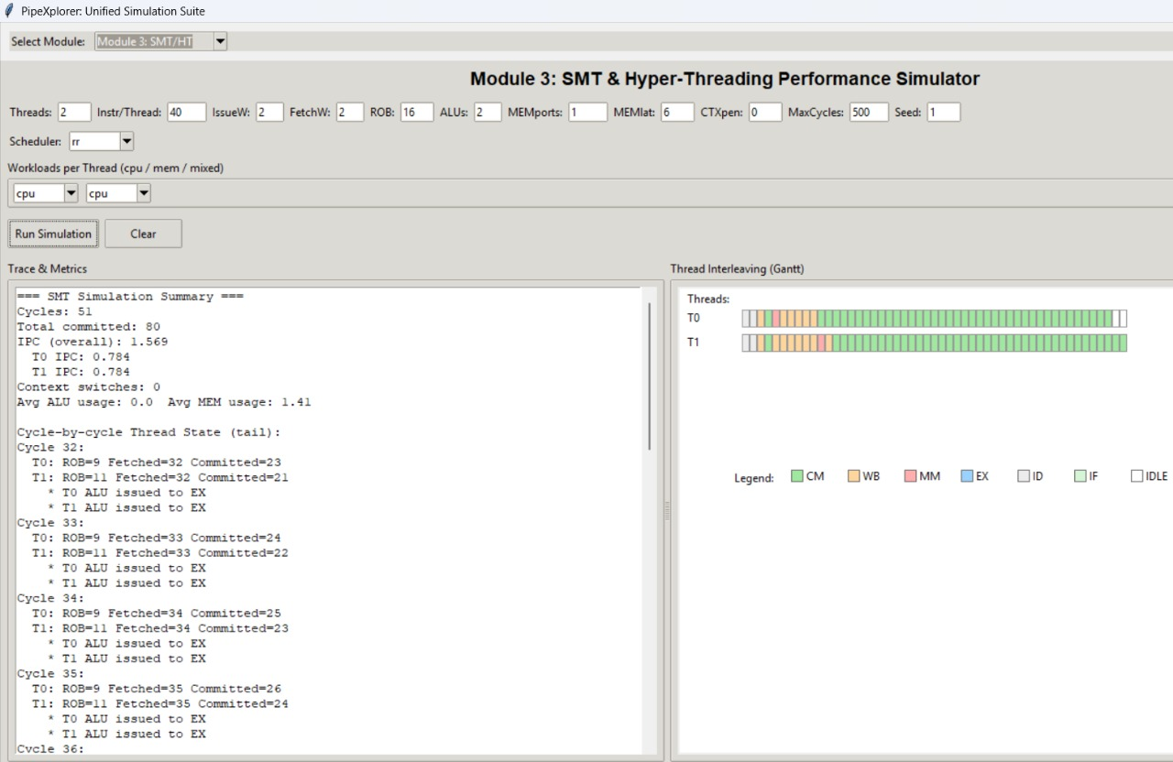

Slide 14
Integration of Modules
PipeXplorer provides a unified framework that integrates pipeline, superscalar, and SMT simulations in a single platform. It manages data flow between modules and offers a common interface for user input and configuration. Users can easily run the same benchmark across all modules, enabling consistent comparison and analysis of different processor architectures and execution models.
Integrated simulation of pipeline, superscalar, and SMT.
Unified interface for configuration and data flow.
Run benchmarks across all modules for comparative analysis.

Slide 15
Conclusion
We developed PipeXplorer, a program designed to help students understand how CPUs work by visualizing concepts such as pipelines, superscalar execution, and simultaneous multithreading (SMT). The tool makes it easier to grasp complex topics by showing hazards, out-of-order execution, and the effects of multi-threading in an interactive and accessible way, ultimately simplifying and enriching the learning experience of CPU architecture.

Slide 16
Challenges Faced
Unexpected behavior when functions or Tkinter event handlers execute out of order.
Logical errors in loops or if-else statements producing incorrect outputs.
Runtime errors like NoneType exceptions or missing widget references.

Slide 17
FUTURE SCOPE
Extend support to multi-core and heterogeneous processor architectures.
Integrate advanced branch prediction, energy, and power analysis.
Incorporate AI-driven optimization techniques for performance improvement.
Develop cloud-based or web-accessible versions for remote collaboration.
Make the platform more comprehensive for academic and industrial use.
Enhance visualization tools and automated performance reporting.

Slide 18
REFERENCES
Nemirovsky, M., & Tullsen, D. M. (2022). Multithreaded Processor Design: A Unified Approach. Springer.
Giorgi, R. (2023). FREESS: Educational Simulator of a RISC-V-Inspired Superscalar Processor. Springer.
Ortiz-Arroyo, D., & Lee, B. (2024). Dynamic Simultaneous Multithreaded Architecture. Wiley.
Jaros, J., Majer, M., Horky, J., & Vavra, J. (2024). Superscalar RISC-V Processor Simulation. CRC Press.
Cheng, S., Zhang, R., He, W., Jin, P., & Li, C. (2025). Automated Superscalar Processor Design and Optimization. Elsevier.

Slide 19


